Slide 1

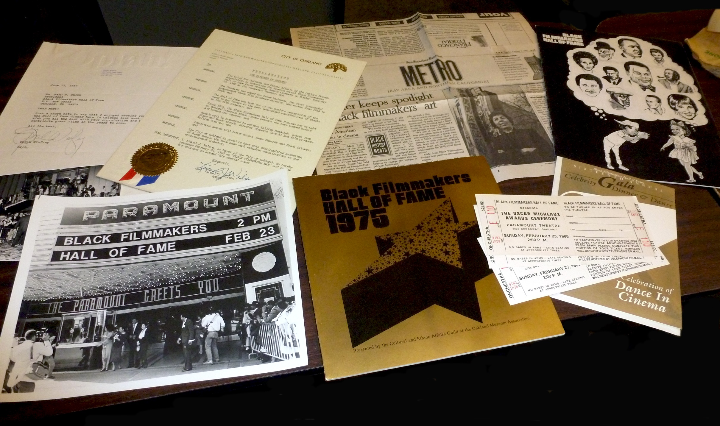
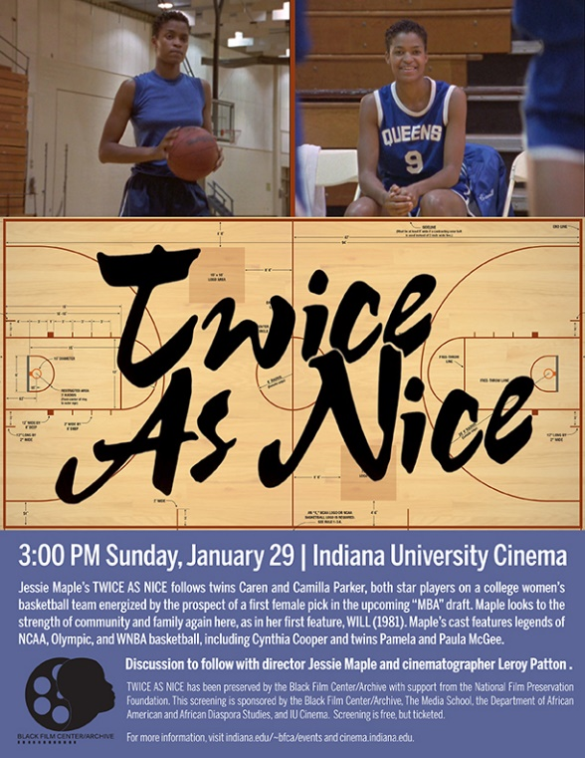
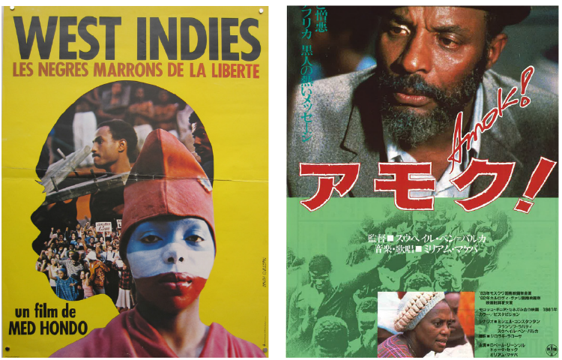
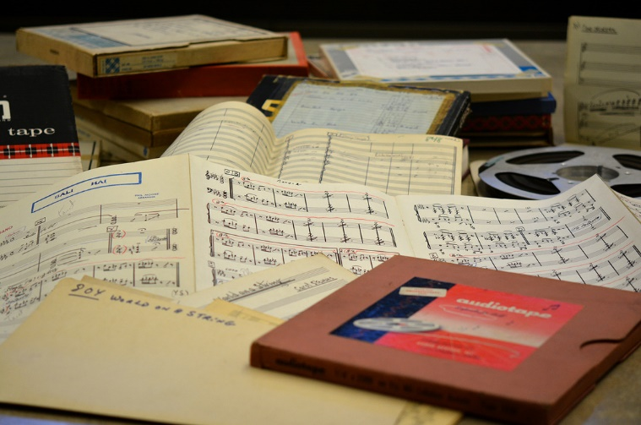
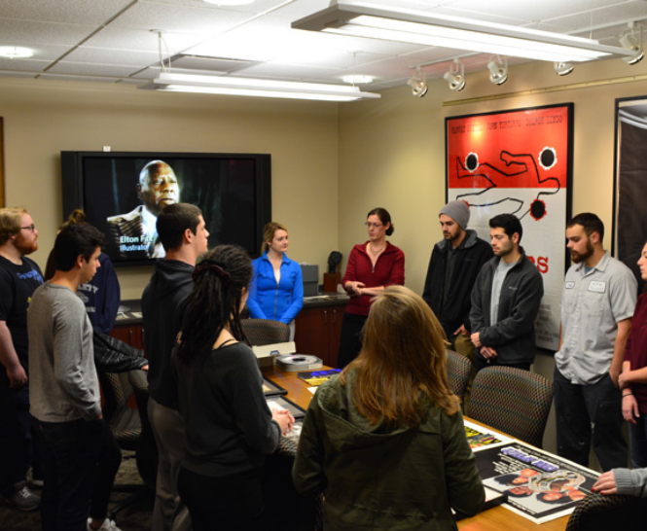
Indiana University
Black Film Center/Archive
Black Filmmakers Hall of Fame Archives
Josef Gugler African &
Middle Eastern Film Collection
Jessie Maple Collection
Ronda L. Sewald, Archivist
rsewald@indiana.edu
Wells Library, Rm. 044
Phil Moore Collection
General Collections

