Slide 1
Bang the Drum for Jesus
Civilian Uprisings against the Use of Musical Warfare by the Early Salvation Army
Ronda L. Sewald
rsewald@indiana.edu
April 13, 2013
IU Cultural Studies Program Seventh Annual Conference

Slide 2
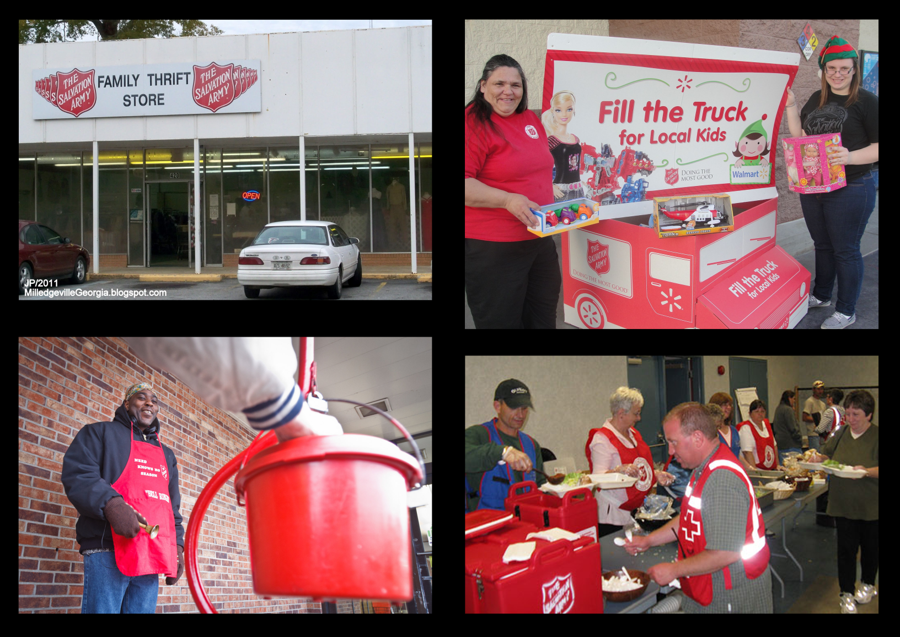
Today’s Salvation Army at Work

Slide 3
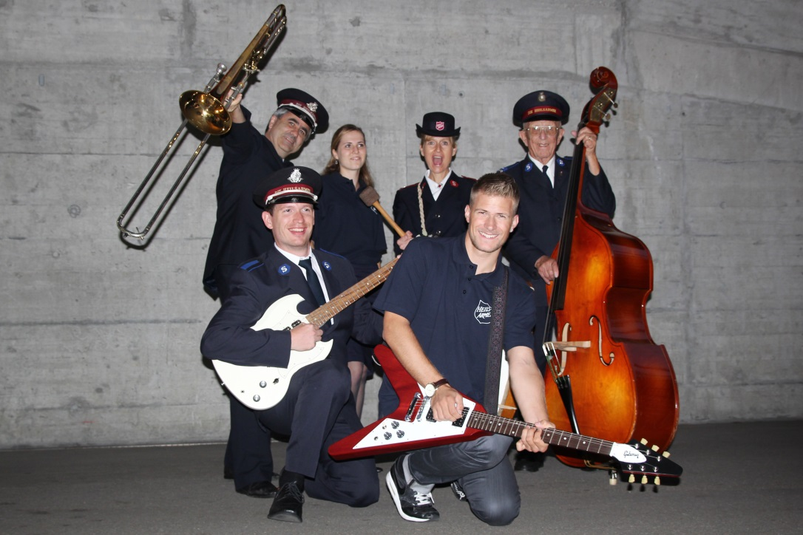
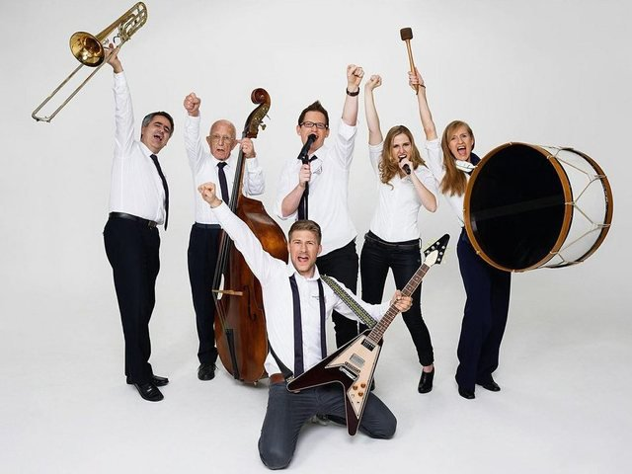
Takasa
Swiss Eurovision Song Contest entry for 2013

Slide 4
Depiction of a Confrontation between the Skeleton Army and Salvation Army in London
“A Quiet Sunday in London or, the Day of Rest,” Punch, 20 Mar. 1886.

Slide 5
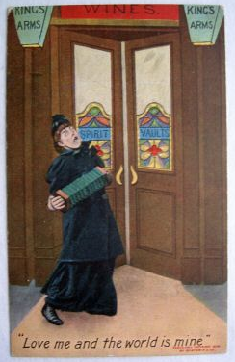
Salvation Lassie Deterring Patrons from Entering a Bar
“Love Me and the World Is Mine” [postcard] (ca. 1905)
Bamforth and Co., series 1426.

Slide 6
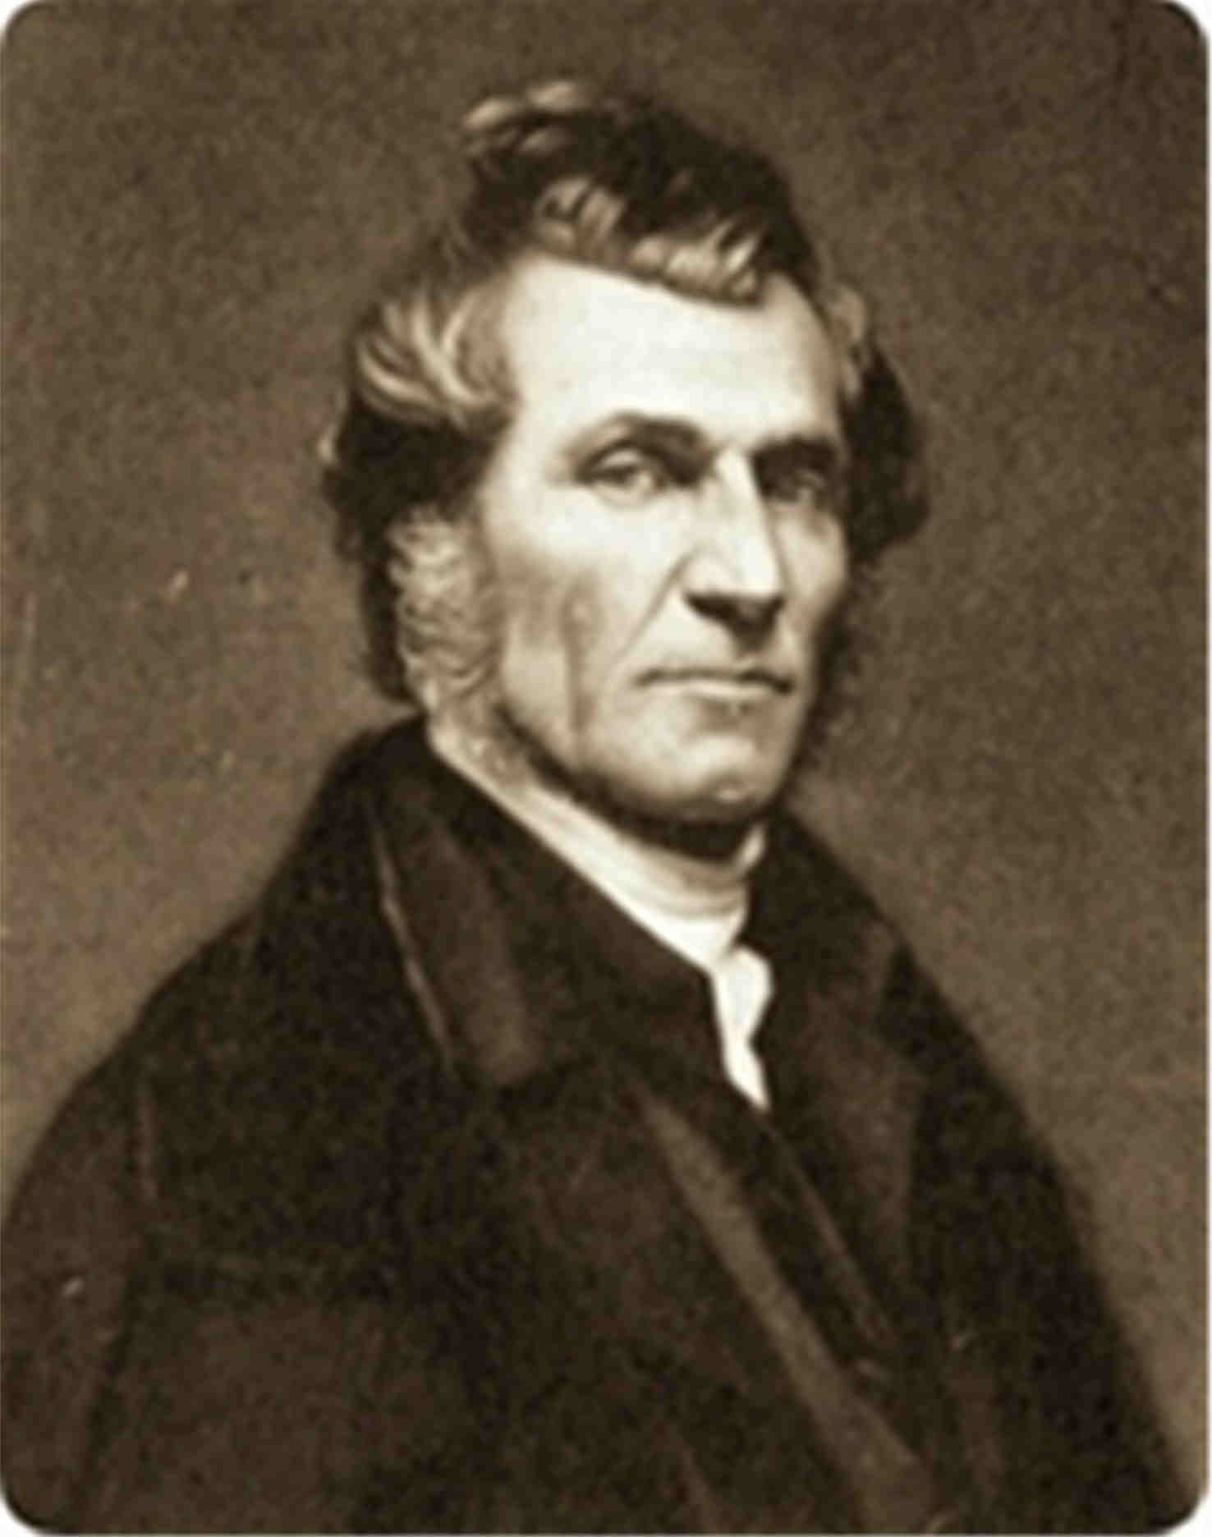
James Caughey (1810-1891)

Slide 7
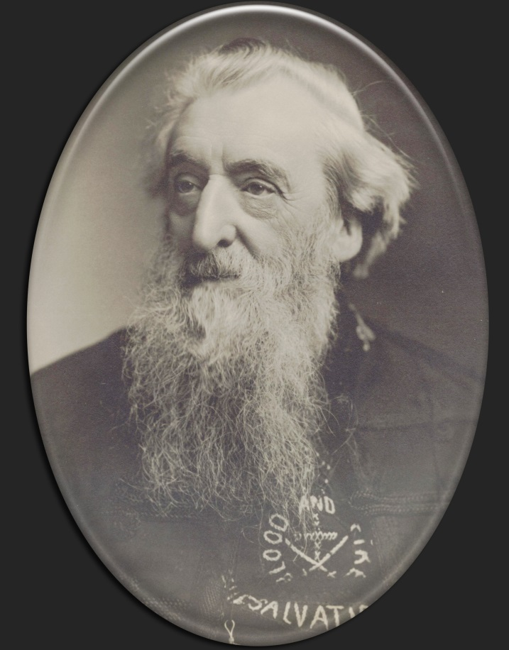
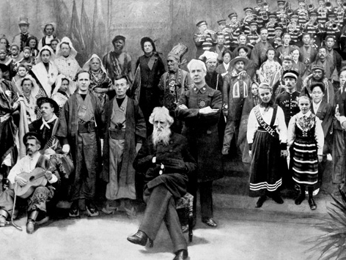
General William Booth (1829-1912)

Slide 8
“We Shall Win America” by Bramwell Booth
We shall win America for our heavenly King;
Hear its dying millions of salvation sing,
Washed in the blood of the Lamb.
We will plant our colors in every state and clime,
Loudest hallelujahs from all our soldiers chime—
Washed in the blood of the Lamb
CHORUS:
We shall win America over to our King;
Hear its dying millions of salvation sing.
Hurrah! Hurrah! The day of victory’s nigh.
Fight on! Fight on! We’ll conquer or we’ll die.

Slide 9
But what if they kill you? Well, you must die. You have often sung and said that you would. Now here’s a chance. Make up your mind to the worst; then perhaps he that would lose his life shall save it.
- General William Booth
Orders and Regulations for
Field Officers of The Salvation Army

Slide 10
Cathedral of the Open Air

Slide 11

“Salvation Army Song: My Heart’s Door Wide I’m Swinging” performed by [H.S. Dudley and the Columbia Male Quartet]. Columbia Salvation Army Series 30901. Broadcast on Radio Dismuke, 28 Oct. 2008.

Slide 12
“Imitation of a Meeting of the Salvation Army” performed by George Graham. 7” Zonophone Arch 1391.
Captain: All right now, brothers and sisters, I am glad to see such a large crowd here this evening, hallelujah! I shall now introduce one of our latest converts, by the name of Tuck Tommy, who used to be a member of the Dirty Dozen, but he’s saved now, hallelujah! And he’ll get up and relate his experience.
Narrator: Now Tommy gets up.
Tommy: Well, brothers and sisters, brothers and sisters. I’m pleased and happy that I can get up in this meeting this evening and tell you that I’m saved, see? And I am saved, too. That’s dead straight. There’s no bluff about that. And some of you blokes and mugs who are sitting out there, come up and get save you’d be better off, too, see?

Slide 13
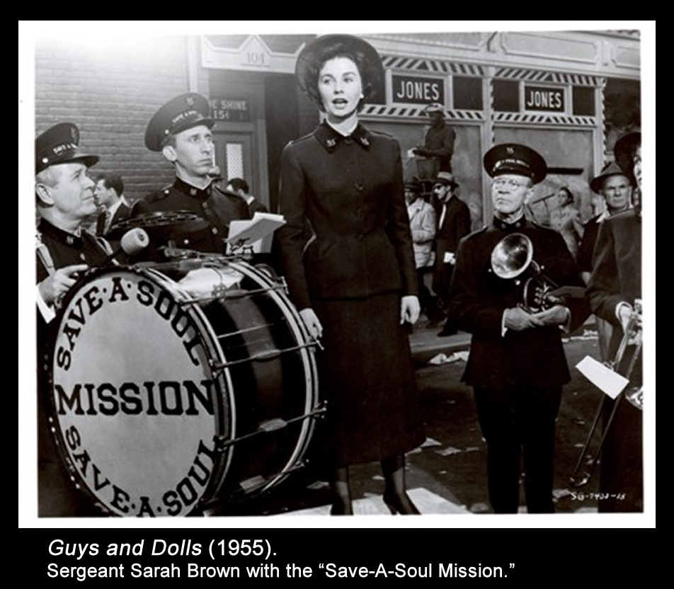
Army Parodies Targeting the Drum

Slide 14
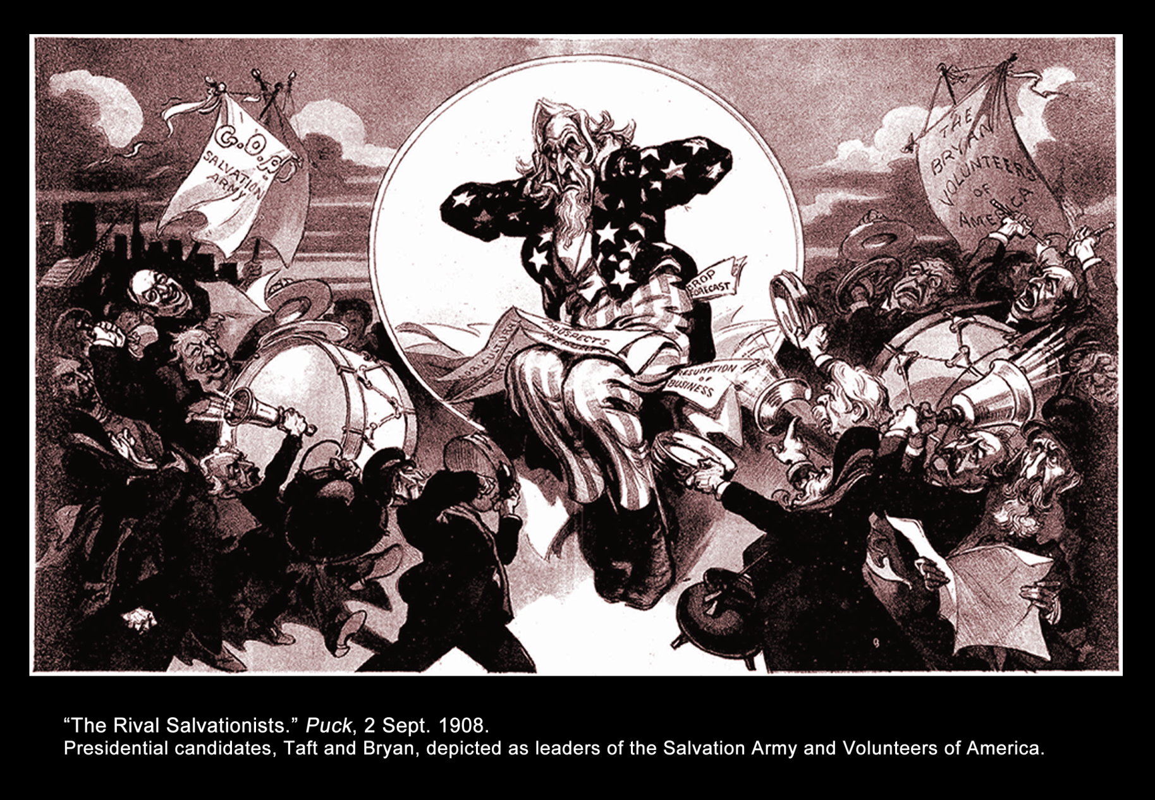
Army Parodies Targeting the Drum

Slide 15
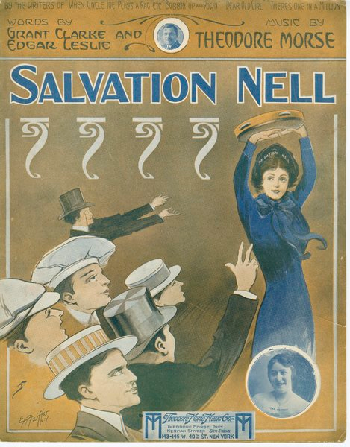
“Salvation Nell” (1913) performed by the Peerless Quartet. Edison Blue Amberol 2027.
Army Parodies Targeting the Drum

Slide 16
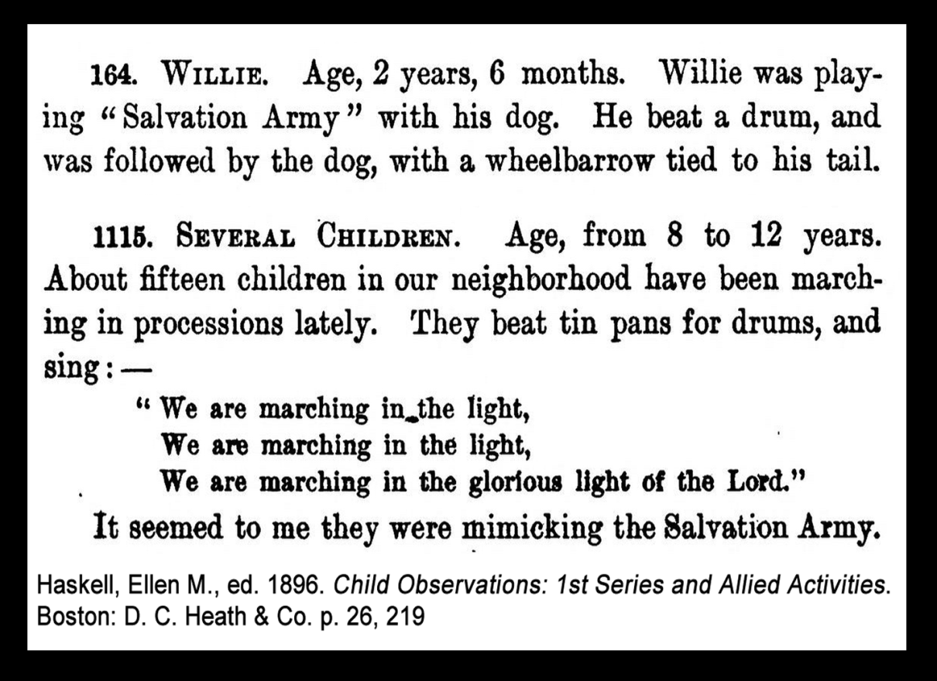
Army Parodies Targeting the Drum

Slide 17
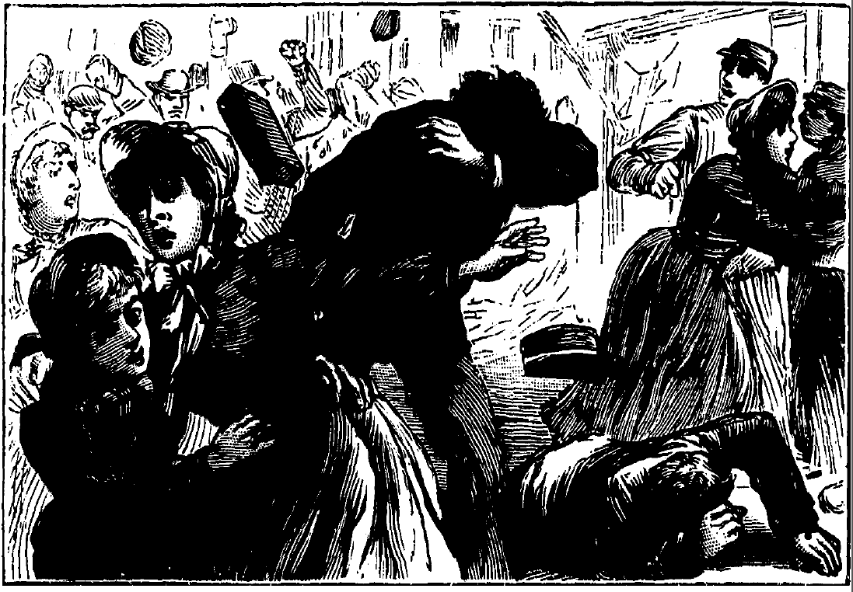
“Mobbing Salvationists,” The National Police Gazette 9 Jul. 1887.

Slide 18
Mr. Jones, our landlord, whose house is next to the Barracks, has been complaining about our beating the drum inside on Sunday mornings. I hear that he is in the habit of making up his weeks’ accounts at these times, and I suppose he probably speaks the truth when he says we disturb him. At any rate, I think it would be wise to discontinue this practice, for a time at least, as he may turn us out, and shall do so unless I hear from you to the contrary.
- Template from
Orders and Regulations for
Field Officers of The Salvation Army

Slide 19
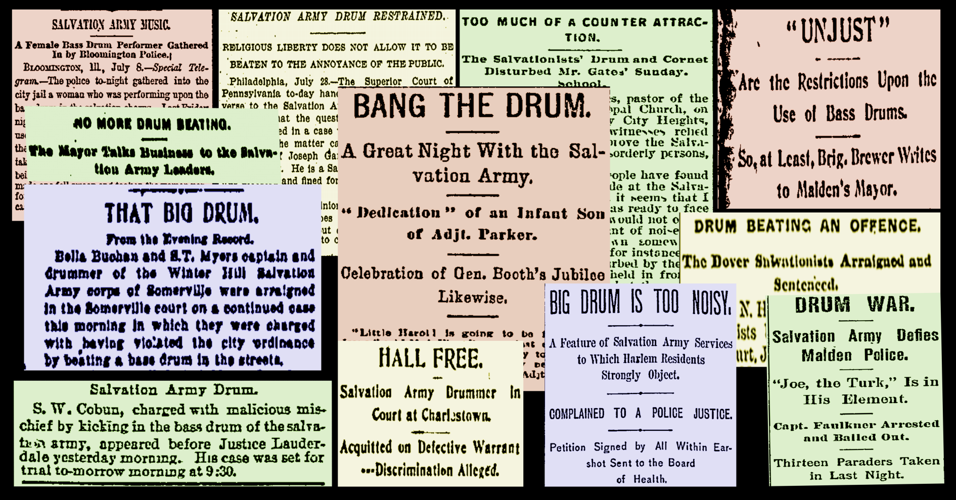
Select headlines about the Army drum from across the US in the ’80s and ’90s

Slide 20
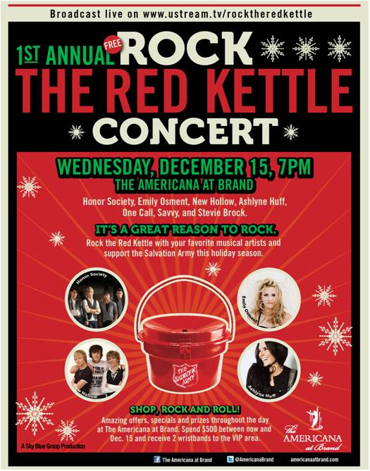
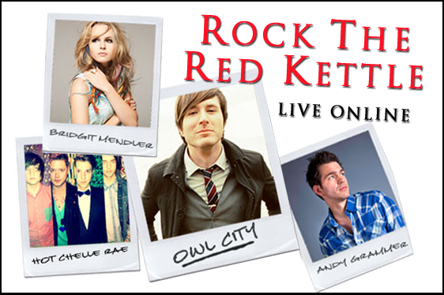
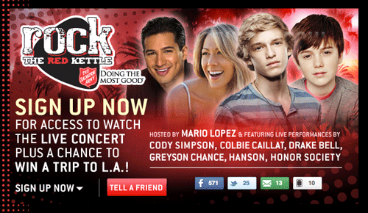
Rock the Red Kettle Concert

Slide 21
Role of the Drum
GOD
Middle
Classes
Altar, tool for worship,
sign of devotion, offertory plate
Nuisance or necessary evil?
Salvation
Army
Weapon
SATAN
Attention getter & tool for inclusion
or nuisance & weapon?
Lower Classes

Slide 22
Bang the Drum for Jesus
Civilian Uprisings against the Use of Musical Warfare by the Early Salvation Army
Ronda L. Sewald
rsewald@indiana.edu
April 13, 2013
IU Cultural Studies Program Seventh Annual Conference

