Slide 1

Richard E. Norman and Race Filmmaking
Black Film Center/Archive
Ronda L. Sewald, Archivist
rsewald@indiana.edu
Wells Library, Rm. 044
Appointments: M-F @ 9-4:30

Slide 2
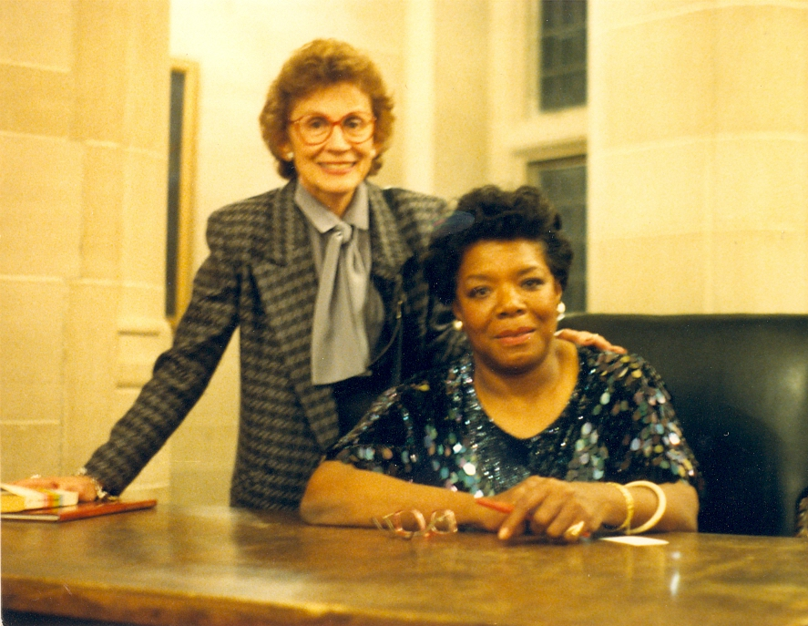
History of the Black Film Center/Archive
Black Film Center/Archive
Founded in 1981 by Dr. Phyllis Klotman
IU Professor of African and
African American Diaspora Studies
Research area in film but had problem
locating sources
Couldn’t find a Black Film Archives,
so she decided to build her own
BFC/A founding director Phyllis Klotman with
former US poet laureate, Maya Angelou

Slide 3
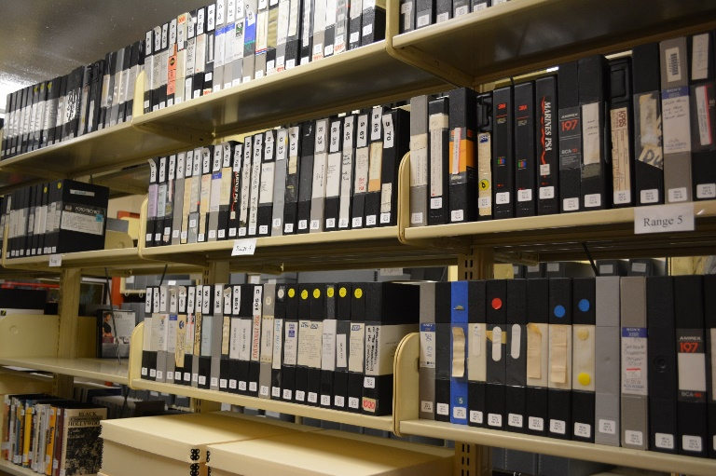
Formats
Black Film Center/Archive
Films (16 mm and 35 mm)
Posters
Lobby cards
Pressbooks and press kits
Oral history, interview, and lecture
recordings with filmmakers and artists
Papers of filmmakers
Organizational records (Black Filmmakers
Hall of Fame)

Slide 4
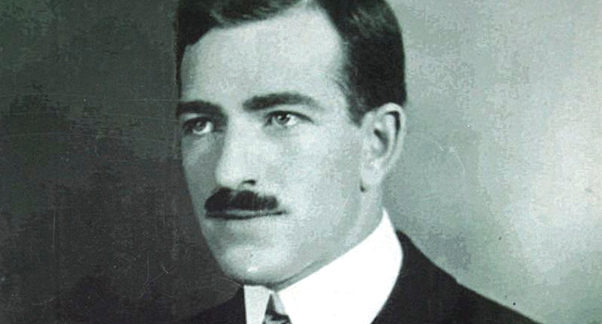
Richard E. Norman and Race Filmmaking Collection
Black Film Center/Archive
White producer of silent films
Active in film production 1912-1928
Produced silent films
Distributed primarily in the South or through 3rd parties
Full distribution territory ranged from New York to Texas
Distributed films for other directors

Slide 5

Notable Things about Norman
Black Film Center/Archive
Home talent pictures
Worked with black and white casts
Created and distributed early race films
Kept everything
  Receipts, censorship records, publicity, correspondence, etc.

Slide 6
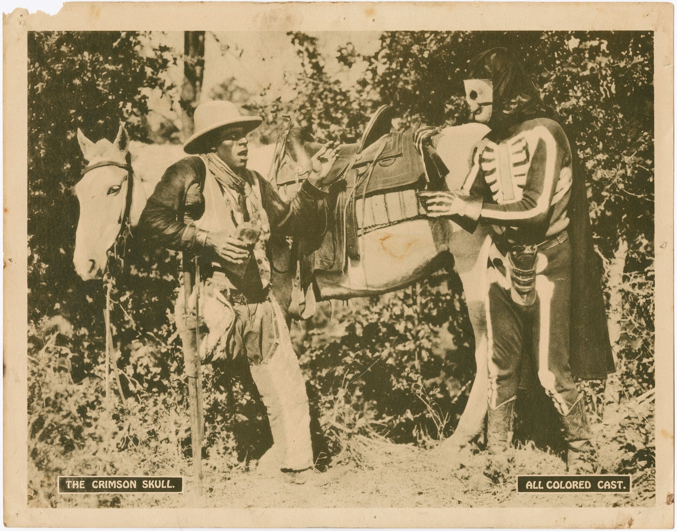
Norman Films with Black Casts
Black Film Center/Archive
The Green Eyed Monster (ca. 1916)
The Bull-Dogger (1921)
The Crimson Skull (1921)
Regeneration (1923)
The Flying Ace (1926) - Most
successful film, grossing ~$20,000
Black Gold (1928)

Slide 7
Accessing material
Black Film Center/Archive
Full collection digitized from 2015-2018 as part of an NEH grant
Accessible through Archives Online at IU (minus films):
http://purl.dlib.indiana.edu/iudl/findingaids/bfca/VAC1152
Films accessible online (YouTube, Library of Congress) or through screening appointments at the BFC/A

Slide 8

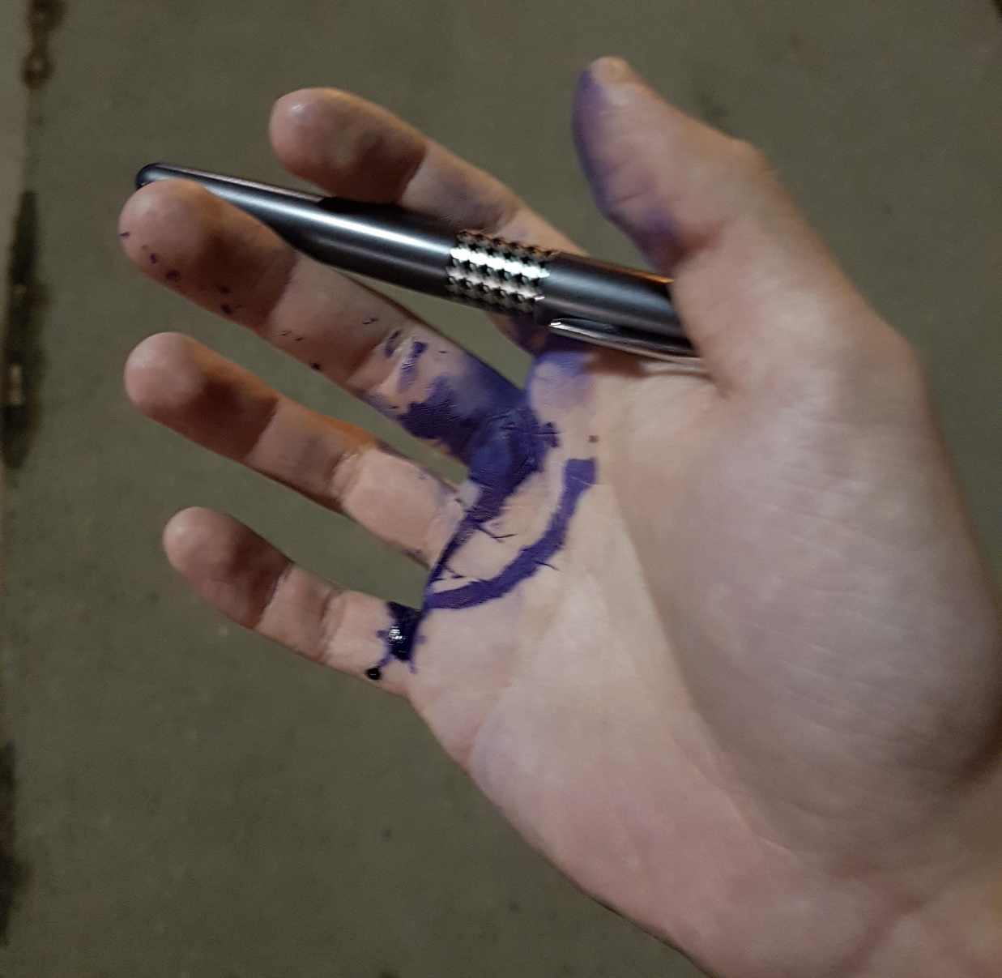



Rules for Working with Materials
Black Film Center/Archive
No food, beverages, or bags outside this room
No pens allowed (Pencils available at front desk)
DO NOT handle the materials without asking me
You may take photos for later reference
DO be curious and ask questions

Slide 9
Richard E. Norman and Racefilmmaking
Black Film Center/Archive
Ronda L. Sewald, Archivist
rsewald@Indiana.edu
Wells Library, Rm. 044
Appointments: M-F @ 9-4:30

